Slide 1
Final Excel presentation
BY
Name: Sangavi V
EmpId:4302

Slide 2
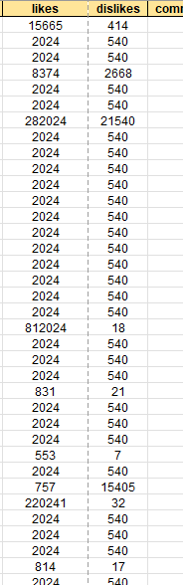
Ques-01(Data Cleaning)
Inference
In order to have a good analysis we need a clean data
Steps:
Removed the duplicates
Checked for the blank columns
Filled the null value with mean.
Null value in likes and dislikes are replaced with means.

Slide 3
Ques-02
Inference The datas can be seen and distributed the values according to the range of dates

Slide 4
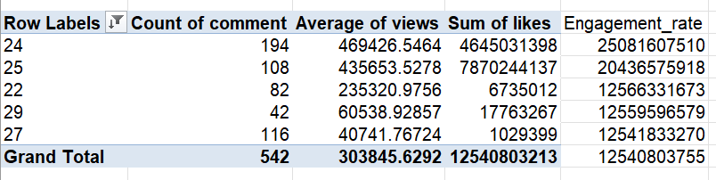
Ques-03
Inference
Engagement rate can determine how the video is interesting .

Slide 5
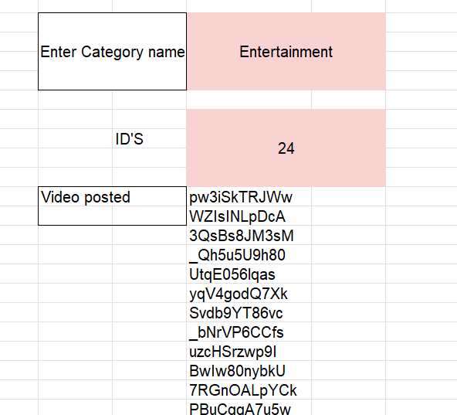
Ques-04
Inference Xlookup along with filter is used for dynamic retrieval from different tables

Slide 6
Ques-05(Text Analysis)
Inference
In order to make the analysis regarding the text we need to use certain text conditioning formulas to make the process effective
Steps/Formulas
Concatination (=CONCAT(A2,B2))
Textjoin{used to bring multi line in single line) =TEXTJOIN("#",TRUE,Ques_1!O2)

Slide 7
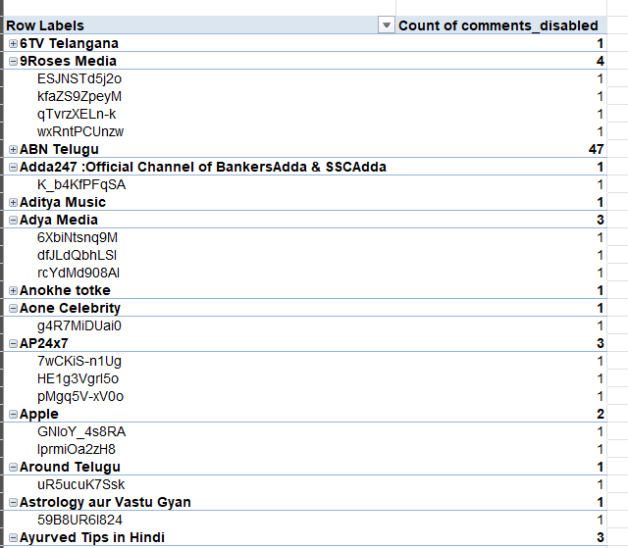
Ques-06(comment analysis)

Slide 8
Ques-06(comment Analysis)
Inference
To improve the performance and usability feedback from the users are very important
Steps/Formulas
Calculated comment disabled.
Grouped the channels
Displayed the video id according to the comment disabled option.

Slide 9
Ques-07(visual creation)

Slide 10
Ques-07(visual creation)
Inference
Based on the attributes of the data its easy to visualize and understand the trend.
Steps/Formulas
Used pivot table
Compared the sum of views,likes,comments with the different categories.
Added filters for dynamic filtering (like based on the comments we can filter the respective channel title)

Slide 11
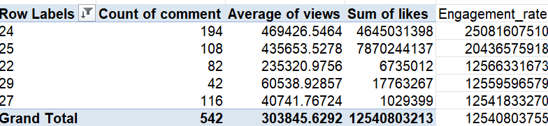
Ques-08(Top 5 &Bottom 5)

Slide 12
Ques-08(Top 5 &Bottom 5)
Inference
In order to understand the performance of each categories of videos the analysis is done based on the engagement rate(likes+comments).
Steps/Formulas
Engagement rate is calculated
Average of likes and engagement rate is done.
Sorted on the basis and retrieved the top 5 categories which people watch often.

Slide 13
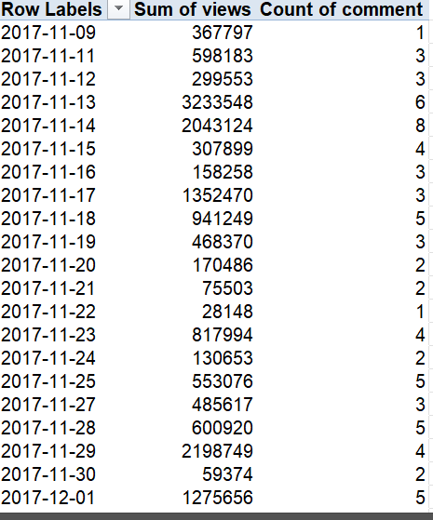
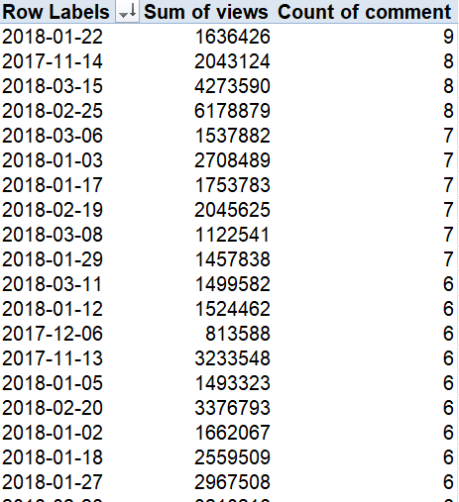
Ques-09(Filtering by conditions)

Slide 14
Ques-09(Filtering by conditions)
Inference
Based on the trends we can apply conditions and filtering to have a quick retrieval of data for analysis
Steps/Formulas
Used pivot table
Calculated the sum of views and count of comments.
Applied filters (sorting based on views)
Selecting based on the comments.

Slide 15
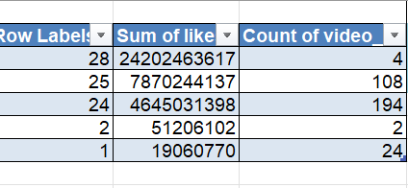
Ques-10()
Inference The sum of like and comments and videos can help in analysing the past records.

Slide 16
Ques-11(Cohorot Analysis)
Inference Percentage which the revenue is saved from previous

Slide 17
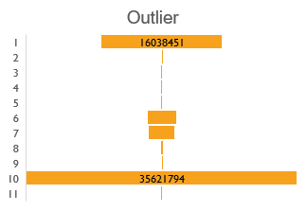
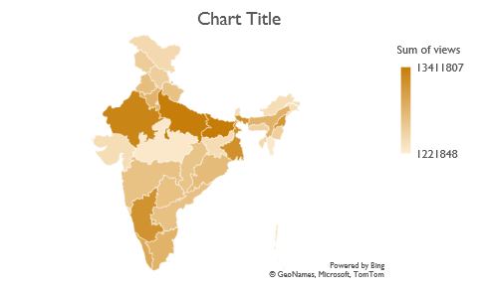
Ques-16-20

Slide 18
Ques-16-20
Inference
According to the dashboard above we can infer different maps and charts
Steps/Formulas
It will be easy to view the data than looking it
Creating it with hands on and dynamically will help in easy access.

